Slide 1



FIRST
GENERAL
MEETING
Enjoy Some Free Food
Room Tschannen 1001
-New Science Building
Date September 5, 2023
Time – 6:00pm – 7:00pm
Meet the SHPE Officers
Meet your peers
Discuss the new semester
Society of Hispanic
Professional Engineers
Notes:
FIRST
GENERAL
MEETING
Room Tschannen 1001
Society of Hispanic
Professional Engineers
-New Science Building
Date September 5, 2023
Time – 6:00pm – 7:00pm
Meet the SHPE Officers
Meet your peers
Discuss the new semester
Enjoy Some Free Food

Slide 2
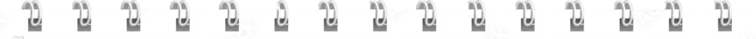
FEB
MAR
APR
27
5
16
Sep 5, 2023
OCT
NOV
NOV
17
14
28
Room - Tschannen 1001
Time - 6pm – 7pm
Society of Hispanic
Professional Engineers
Notes:
Meeting Schedule
2023
Sep 5, 2023
Society of Hispanic
Professional Engineers
SEP
5
SEP
19
OCT
3
OCT
17
NOV
14
NOV
28
Room - Tschannen 1001
Time - 6pm – 7pm

Slide 3

Fifth General Meeting
Special Guests
Siemens Mobility
Room Tschannen 1001
Enjoy Some Free Food
-New Science Building
Date March 05, 2024
Time – 6:00pm – 7:00pm
Discover the opportunities Siemens has to offer.
Network with Siemen professionals
Learn about Siemen’s Internship Opportunities
Society of Hispanic
Professional Engineers

Slide 4


Mock Interview Workshop
Special Guests
Whiting-Turner
Room Tschannen 1001
Enjoy Some Free Food
-New Science Building
Date - February 27, 2024
Time – 6:00pm – 7:00pm
Bring Your Resume
Gain Real Interviewing Experience
Internship Opportunities
Networking Opportunities
Society of Hispanic
Professional Engineers
Society of Hispanic
Professional Engineers

Slide 5



SHPE Alumni Panel: Inspiring Success
Fourth General Meeting
6:00pm – 7:00pm
Room Tschannen 1001
Oct 3, 2023
Enjoy Some Free Food
Connect with National Conference/GMiS attendees.
Learn about their paths to Google, Lockheed Martin, General Motors, and Accenture through conference attendance.
Connect with professionals in the industry.
Society of Hispanic
Professional Engineers

Slide 6

Sixth General Meeting
Resume & Elevator Pitch Workshop
Room Tschannen 1001
Oct 17, 2023
6:00pm – 7:00pm
Enjoy Some Free Food
Special Guests ECS Career Center
Update your resume to land an Engineering or Computer Science job.
Create an elevator pitch to make a meaningful impression when meeting recruiters.
Stand out at networking events and job interviews
Society of Hispanic
Professional Engineers

Slide 7

Fifth General Meeting
Special Guests
General Motors
Room Forrest Suite
-University Union 2nd Floor
Enjoy Some Free Food
Date October 10, 2023
Time – 6:00pm – 7:00pm
Are you interested in the automotive industry?
Attend this meeting and increase your chances of landing a General Motors internship.
Network with a General Motors professional
Society of Hispanic
Professional Engineers

Slide 8

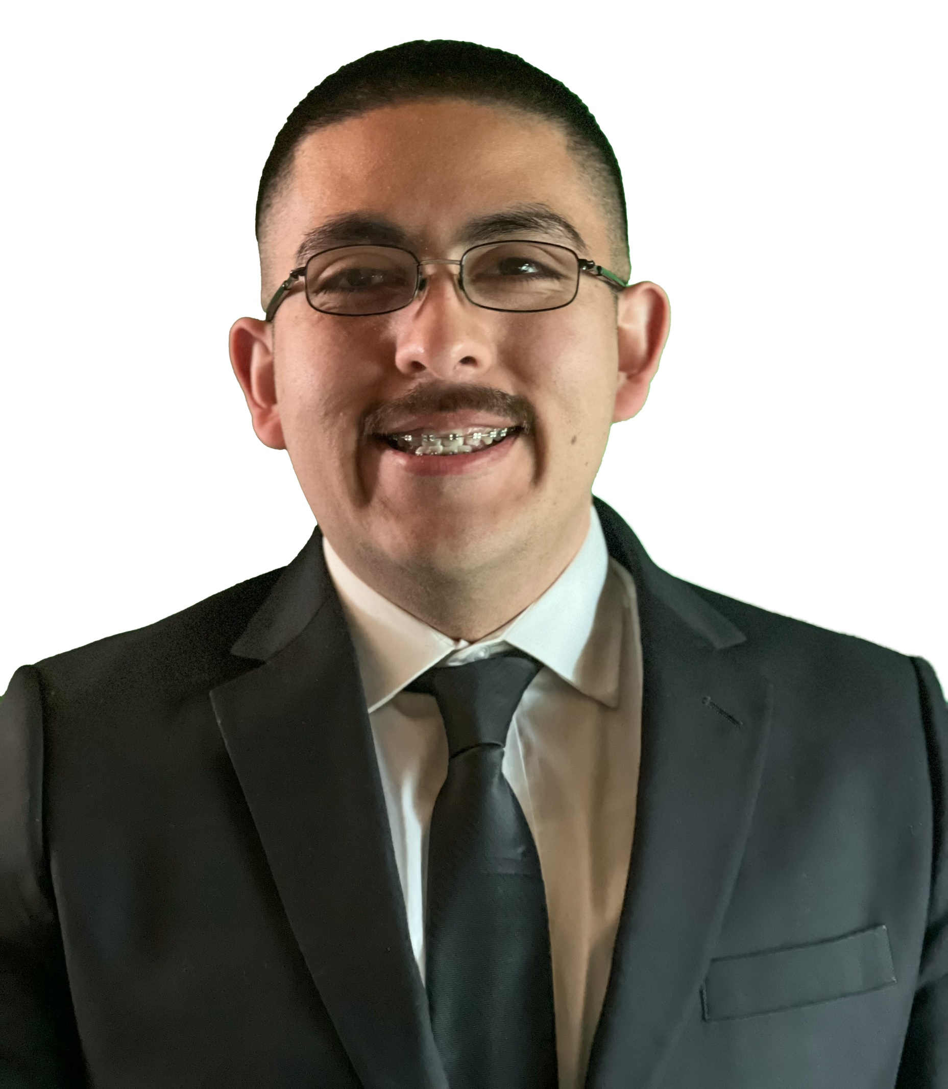

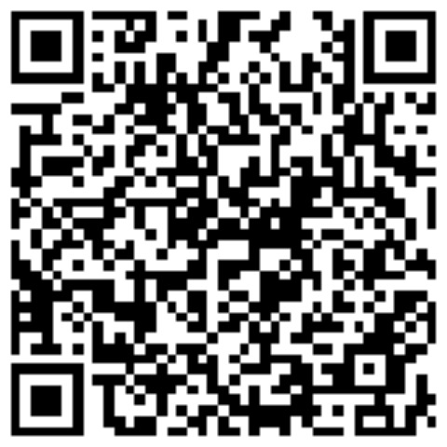
Major
99
CS
Ruben Ortega

Slide 9
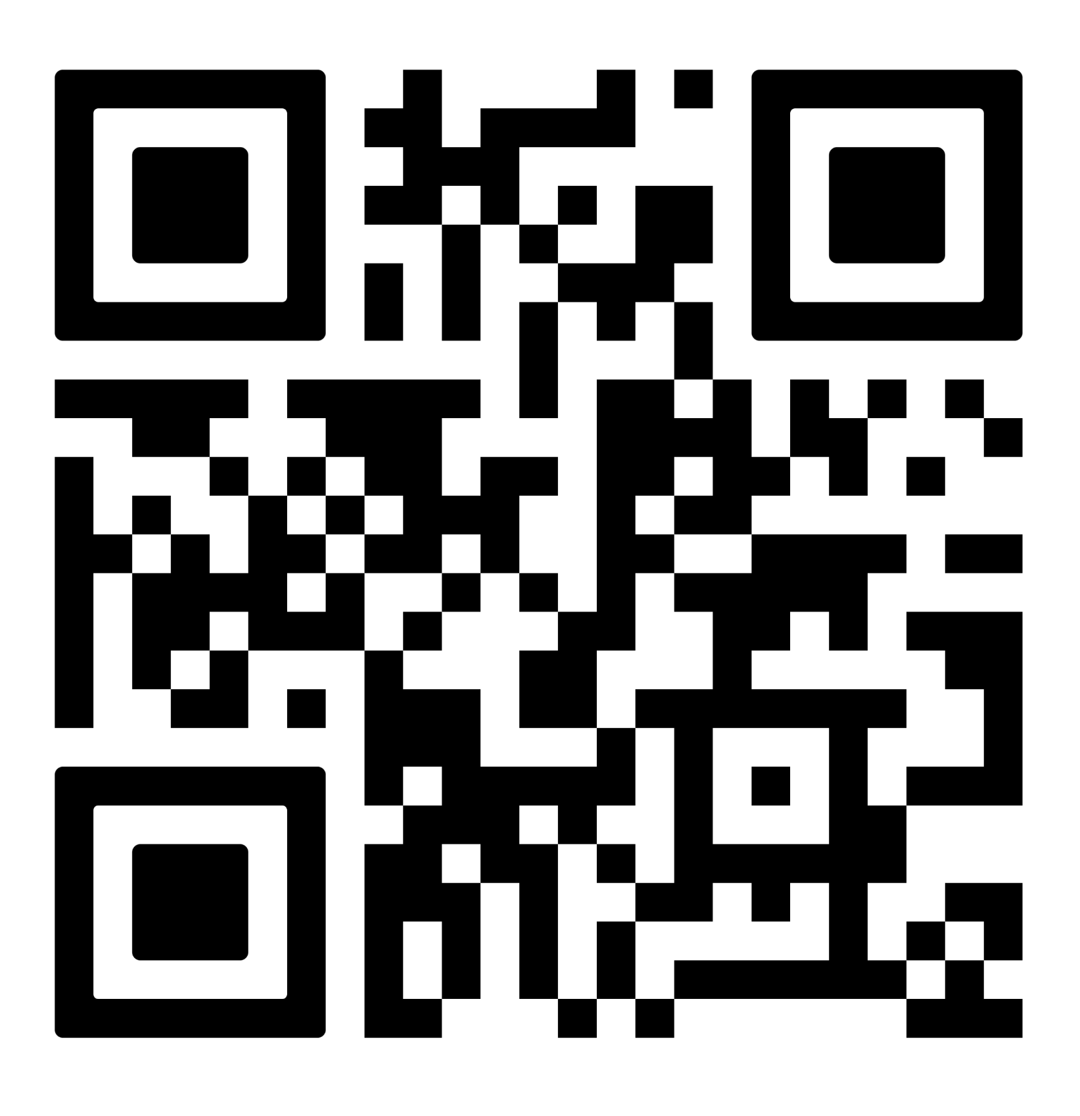
Ruben Ortega
Senior Computer Science Major
7/25
Limited Edition

